Slide 1
History and Present of the Research and Funding in the Social Sciences
Manju S Nair
Dean, Faculty of Social Sciences
University of Kerala

Slide 2
Increase in the recognition of the need and importance of learning social sciences and doing research in social sciences in the 21st century
Much is expected from the social science knowledge and expertise when seeking to solve global challenges
But social science knowledge is at risk in the parts of the world where it is most needed

Slide 3
The three risks
Risk in the divide in the production sites of knowledge
Risk in the divide in the understanding of ‘knowledge’
Risk in the divide in the resources available for knowledge production.

Slide 4
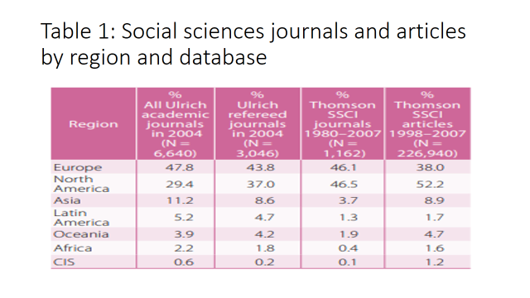
Source: World Social Science Report 2010

Slide 5
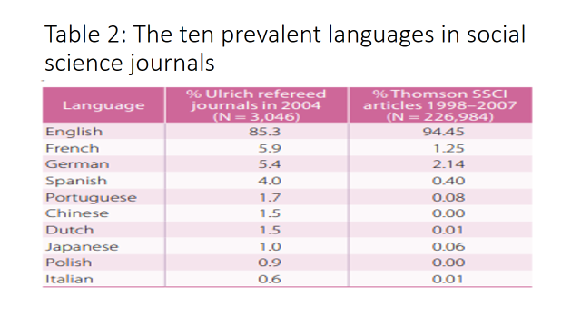
Source: World Social Science Report 2010

Slide 6
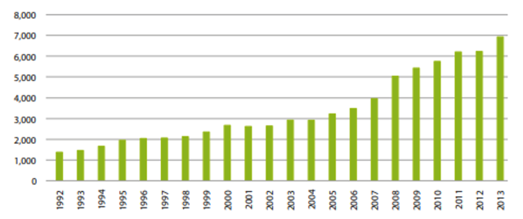
Figure 1: Number of social science and humanities publications on inequalities and social justice produced worldwide per year, 1992-2013
Source: World Social Science Report 2016

Slide 7
Figure 2: Number of social and human science publications on inequality and social justice per region, 1992-2013
Source: World Social Science Report 2016, UNESCO.

Slide 8
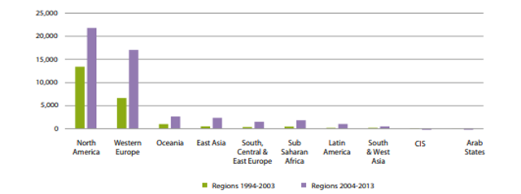
Figure 3: Number of social and human science publications on inequality and social justice per region for two periods, 1994-2003 and 2004-2013
Source: World Social Science Report 2016, UNESCO

Slide 9
Figure 4: Number of social and human science publications on inequality and social justice per country, 1992-2013
Source: World Social Science Report 2016, UNESCO and the ISSC, Paris.
https://unesdoc.unesco.org/ark:/48223/pf0000245825

Slide 10
Divide in understanding what ‘knowledge’ is
How does the global south respond?
It responds by internalizing Western knowledge production norms in order to be visible on the international scientific scene.
Eg from economics

Slide 11
Divide in the resources available for knowledge production.
Higher importance to natural sciences
Capacities to conduct social science research
- at individual level
- at organization level
- at policy level

Slide 12
Social Science Research in India
Four types of institutions
Issues – sea of mediocrity with islands of excellence and visibility
- no significant increase in the number of public research institutions
- only 15 per cent of universities are teaching and research universities
- Issues relating to autonomy
- UGC and ICSSR – Funding issues

Slide 13
Need for revolution – need for alternatives

Slide 14
Thank you

